Slide 1
Cancer
Year 11 Human Biology
ATAR
PowerPoint #16

Slide 2
SCSA Syllabus Reference
uncontrolled division of cells can result in the development of tumours/cancers

Slide 3
Lesson Intention
To introduce the concept of cancer

Slide 4
Success Criteria
define cancer
describe the process of uncontrolled cell division
describe how tumours form

Slide 5
Vocabulary
Cancer: a malignant growth; one that has the capability of spreading to other body parts.
Tumour: an abnormal mass of tissue resulting from uncontrolled division of cells
Malignant: able to spread to other parts of the body
Metastasis: the spreading of tumour cells to form secondary tumours in different parts of the body

Slide 6
Cancer
Normally, cell division is controlled. When it is not, cells divide uncontrollably and this is known as cancer.
This uncontrolled growth of abnormal cells produces a mass, or tumour.
There are many different types of cancer e.g. breast, brain, leukaemia, lung and skin.

Slide 7
Cancer
Cancer cells do not differentiate into the normal tissue cells that surround the tumour. They can therefore easily be identified.
Some tumours are malignant, which means they spread to other parts of the body. This is known as metastasis. In this way, secondary tumours can develop in parts of the body well away from the original tumour.

Slide 8
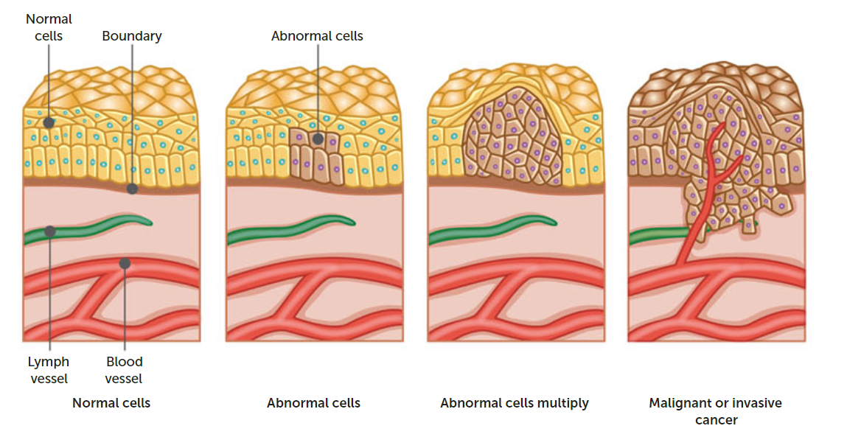

Slide 9
Cancer continued
Some tumours are not malignant as they are not able to invade normal tissues, blood or lymph vessels, and so do not spread throughout the body.
These tumours are called benign. Benign tumours grow and press on surrounding tissues. These tumours can be dangerous if they exert pressure on vital organs such as the brain or if they are found within the lungs.

Slide 10
Causes of Cancer
Some are still unknown.
Certain environmental factors called carcinogens can trigger malignant tumours. Cancer usually only occurs after long exposure to a carcinogen, with some not developing until years later.
Other factors like genetics can also affect the likelihood of developing cancer.

Slide 11
Carcinogens
A great many substances have been found to be associated with cancer
UV radiation
X-rays
Ionising radiation
Viruses such as HPV
Chemical carcinogens e.g. alcohol, asbestos, tar, paints

Slide 12
Prevention of cancer
Many cancers are associated with lifestyle factors
Education and legislation are two ways to help prevent cancer

Slide 13
Recall Knowledge
Explain the difference between a benign and malignant tumour.

Slide 14
Apply Knowledge
Using an example, explain how education can help to prevent cancer

Slide 15
Homework
None this time ☺

Slide 16
Your research task
Use ICT to explore different types of cancers and the treatments currently available
You will need to research three different types of cancers and how they are currently treated.
You have 2 periods in class.

Slide 17
Reading
Pages 261 - 266: Cancer

